Slide 1
Chap4 Theano/Tensorflow

Slide 2
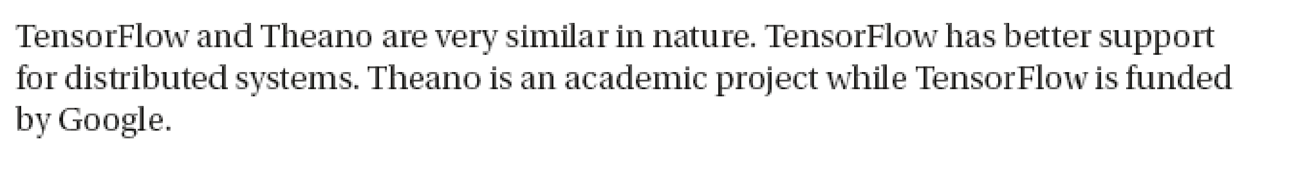
Install
套件(Package) : Theano/Tensorflow
conda install -c conda-forge theano
conda install -c conda-forge tensorflow

Slide 3
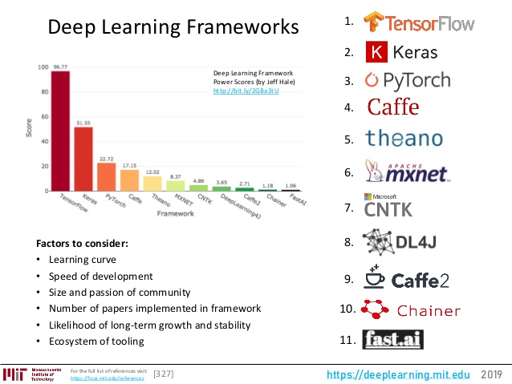

Slide 4
Tensorflow
.TensorFlow是一個機器學習的開發平台，可提供使用者以ANN, CNN, SVM等機器學習演算法開發程式。
2.開發者可使用Python與C++運行Tensorflow，但較多開發者使用Python
3.TensorFlow有cpu與gpu兩個版本，訓練大型的網路時，一般會選用gpu的版本訓練，速度約快數十倍。
4. TensorFlow是Google Brain的第二代機器學習系統。

Slide 5
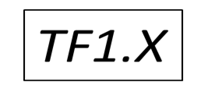
TensorFlow
TensorFlow Core 的程式可分為兩大部分：
1.建立 computational graph。
2.執行 computational graph。
computational graph 是由許多 TensorFlow 運算節點（nodes）所組成的運算藍圖，每個節點可以接受任意個數的 tensors 作為輸入資料（或是沒有任何輸入也可以），並輸出一個 tensor。

Slide 6
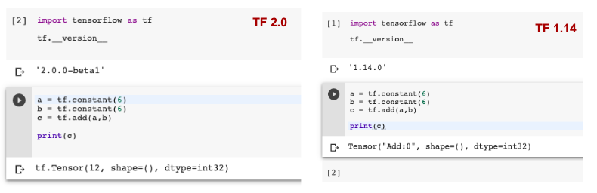
TF 1.X and TF2.0
TF2.0 : No sessions or placeholders.
sess = tf.Session()
Print(sess.run(c))

Slide 7
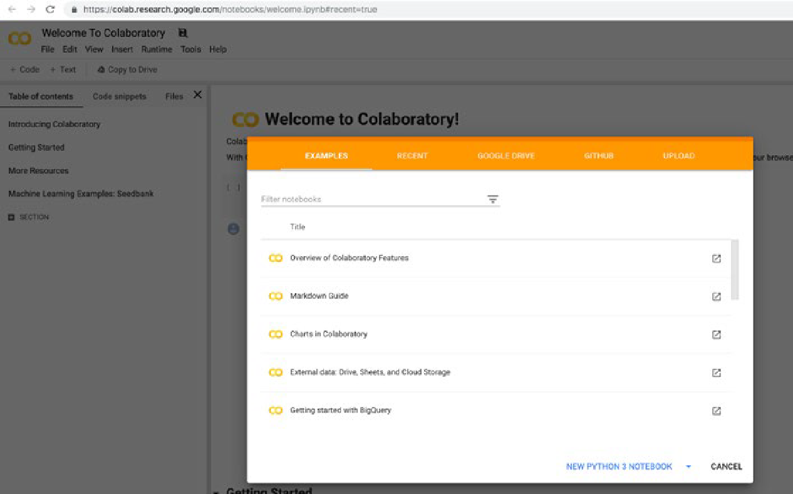
法一: Colab 環境: https://colab.research.google.com/

Slide 8
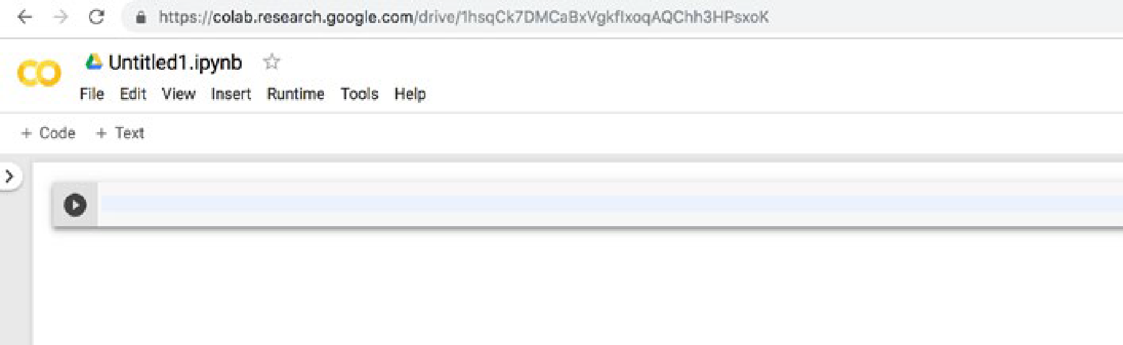
Click New Python 3 Notebook, a new Colab notebook will appear
[In]:! pip install -q tensorflow==2.0.0-beta1
[In]: import tensorflow as tf
[In]: print(tf.__version__)
[Out]: 2.0.0-beta1

Slide 9
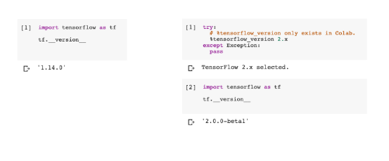
Colab 環境: https://colab.research.google.com/
x = tf.compat.v1.placeholder(tf.float32, shape=(1024, 1024))
y = tf.matmul(x, x)
with tf.compat.v1.Session() as sess:
print(sess.run(y))
rand_array = np.random.rand(1024, 1024)
print(sess.run(y, feed_dict={x: rand_array}))
<<Method 1>>
import tensorflow.compat.v1 as tf
tf.disable_v2_behavior()

Slide 10
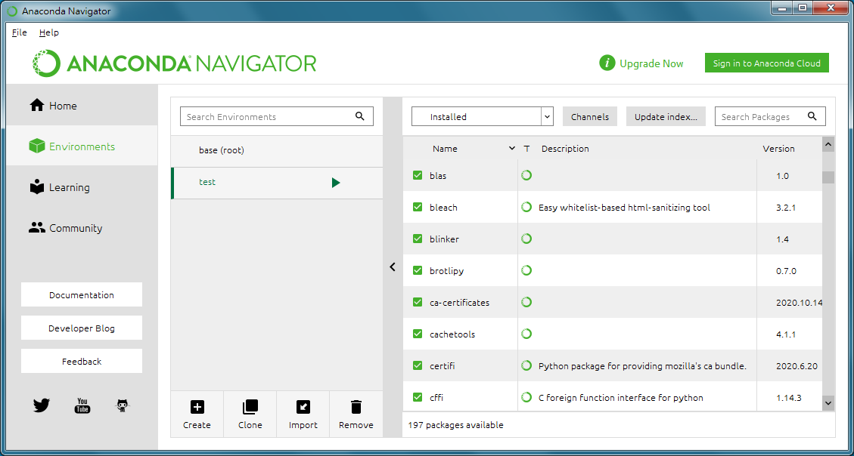
法二 :Anaconda 建立新環境

Slide 11
CPU
conda search tensorflow
conda install tensorflow=1.12.0
GPU
conda search tensorflow-gpu
conda install tensorflow-gpu=1.15.0

Slide 12
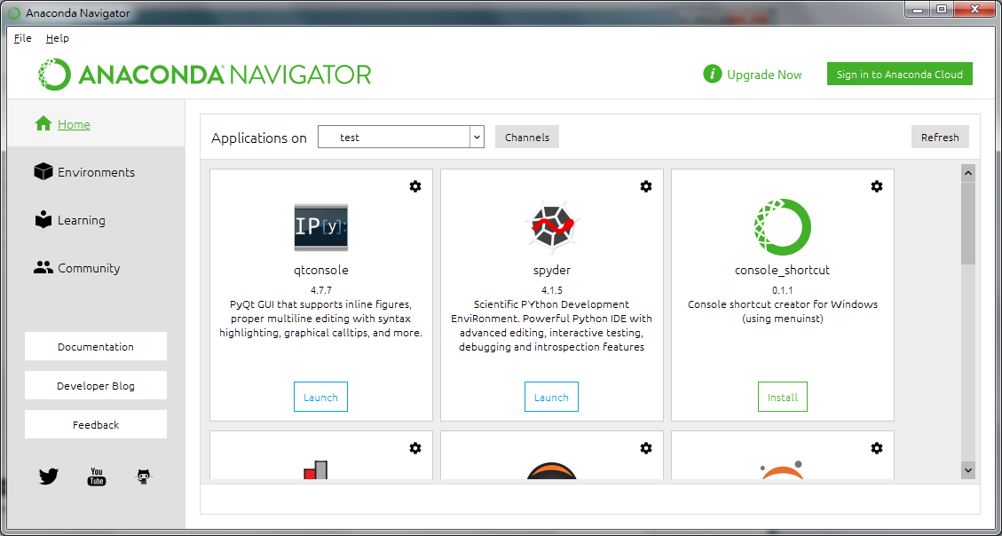
Applications on test open “spyder”

Slide 13

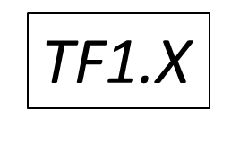
常數節點
import tensorflow as tf
node1 = tf.constant(3.0, dtype = tf.float32)
node2 = tf.constant(4.0)
# 預設型別亦為 tf.float32
如果要讓節點實際進行運算，必須先建立一個 session，然後在 session 中執行 computational graph：
sess = tf.Session()
print(sess.run([node1, node2]))
print(node1)
print(sees.run(node1))
🡺 3.0
[3.0, 4.0]

Slide 14
Python 類型
資料類型 | Python 類型 | 描述
DT_FLOAT | tf.float32 | 32 位浮點數.
DT_DOUBLE | tf.float64 | 64 位浮點數.
DT_INT64 | tf.int64 | 64 位元有符號整數.
DT_INT32 | tf.int32 | 32 位元有符號整數
DT_INT16 | tf.int16 | 16 位元有符號整數.
DT_INT8 | tf.int8 | 8 位元有符號整數.

Slide 15
node3 = tf.add(node1, node2)
print(sess.run(node3))
# 2-D tensor `a`
# [[1, 2, 3],
# [4, 5, 6]]
a = tf.constant([1, 2, 3, 4, 5, 6], shape=[2, 3])
# 2-D tensor `b`
# [[ 7, 8],
# [ 9, 10],
# [11, 12]]
b = tf.constant([7, 8, 9, 10, 11, 12], shape=[3, 2])
# `a` * `b`
c= tf.matmul(a, b)
print(sess.run(c))
🡺 7.0
[[ 58, 64],
[139, 154]]

Slide 16
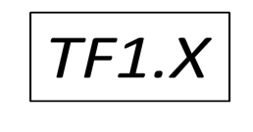
tf.multiply:兩個矩陣中對應元素各自相乘 tf.matmul :將矩陣a乘以矩陣b，
import tensorflow as tf
x=tf.constant([[1,2,3],[1,2,3],[1,2,3]])
y=tf.constant([[0,0,1],[0,0,1],[0,0,1]])
z1=tf.multiply(x,y)
z2=tf.matmul(x,y)
print(sess.run(z1))
print(sess.run(z2))
z1=[[0 0 3]
[0 0 3 ]
[0 0 3 ]]
z2=[[0. 0. 6.]
[0. 0. 6.]
[0. 0. 6.]]

Slide 17
Placeholder
placeholder 是一種可以讓 computational graph 保留輸入欄位的節點，其允許實際的輸入值留到後來再指定。
a = tf.placeholder(tf.float32)
b = tf.placeholder(tf.float32)
adder_node = a + b
這種方式其實有點類似定義一個函數，其接受 a 與 b 兩個輸入參數，並且進行加法運算。

Slide 18
print(sess.run(adder_node, {a: 3, b:4.5}))
🡺 7.5
print(sess.run(adder_node, {a: [1,3], b: [2, 4]}))
🡺[ 3. 7.]
Ex1: Calculate pvalue= c1*a+c2*b
Where c1=5.0 and c2=10.0 are constant.
a and b are placeholder
Print( sess.run(pvalue,{a:3,b:4.5}))
Print( sess.run(pvalue,{a:[1,2,3],b:[4,5,6]}))

Slide 19
Define Variables
可以不斷地更改變數的值
w = tf.Variable(tf.ones((2,2)))
# Initialize the Variables After Invoking the Session
# 變數需要初始化
sess.run(tf.global_variables_initializer())
print(sess.run(w))
[[ 1. 1.]
[ 1. 1.]]

Slide 20
sess = tf.Session()
B = tf.Variable(0, dtype=tf.int64)
# 變數需要初始化
sess.run( tf.global_variables_initializer() )
# 使用 assign 更改變數值
for i in range(5):
print( sess.run(B.assign(i)) ) 🡺
0
1
2
3
4
v = tf.Variable(1.)
print(sess.run(v.assign(2)))
c=v.assign_add(0.5)
print(sess.run(c))
2.0
2.5

Slide 21
Variable with Random Initial Values from Standard Normal
rw = tf.Variable(tf.random_normal((2,2)))
sess.run(tf.global_variables_initializer())
print(sess.run(rw))
tf.random_normal(shape,
mean=0.0, stddev=1.0,
dtype=tf.float32,
seed=None, name=None)
[[ 0.37590656 -0.11246648]
[-0.61900514 -0.93398571]]
TF2.0
tf.random.normal(shape, mean=0.0, stddev=1.0, dtype=tf.dtypes.float32, seed=None, name=None)

Slide 22
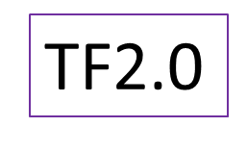
Variable with Random Initial Values from Standard Uniform
W2=tf.Variable(tf.random_uniform(shape=(2,2),
minval=-1,maxval=1))
sess.run(tf.global_variables_initializer())
print(“W2=”,sess.run(w2))
tf.random_uniform(shape,
minval=0,maxval=None,
dtype=tf.float32,
seed=None,name=None)
W2= [[-0.34233093 -0.5155897 ]
[ 0.3379457 -0.7415571 ]]
tf.random.uniform(….)

Slide 23
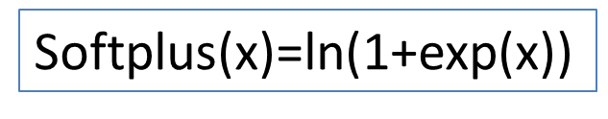
函數向量(I)
import tensorflow as tf
tf.nn.relu
tf.nn.elu
tf.nn.softplus
tf.nn.sigmoid
tf.tanh

Slide 24
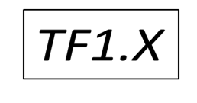
函數向量(I) sigmoid
import tensorflow as tf
a = tf.constant([[1.0, 2.0], [3.0, 4.0], [5.0, 6.0]])
sess = tf.Session()
print(sess.run(tf.nn.sigmoid(a)))
input_data = tf.Variable([[0, 10, -10],[1,2,3]],dtype=tf.float32)
output = tf.nn.sigmoid((input_data))
sess.run(tf.global_variables_initializer())
print(sess.run(output))
a = tf.placeholder(tf.float32)
out= tf.nn.sigmoid((a))
print(sess.run(out,{a: [1,2]}))
[0.7310586 0.880797 ]

Slide 25
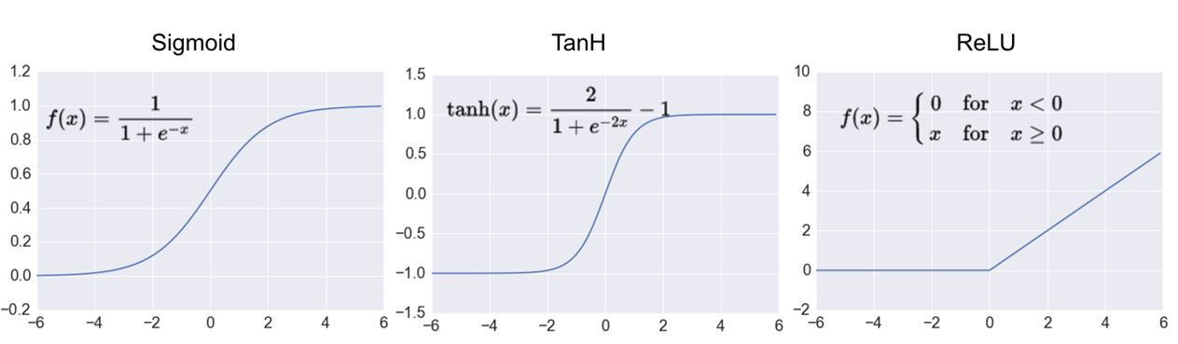
Use tensorflow
Ex2 : (a) Find tanh([-2,0,1])=?
(b) If f1(x) is sigmoid , find f1([-1,0,2,3])=?
(C) If f2(x) is ReLU, find f2([-5,0,3])=?

Slide 26
向量微分(I)
Z=tf.gradients(ys, xs) # dys 對 dxs 的導數
Ex: d(3x^2+5x)/dx=?
import tensorflow as tf
x = tf.placeholder(tf.float32)
y=3*x*x+5*x
z = tf.gradients(y,x)
sess = tf.Session()
print(sess.run(z,{x:[1,2,3]})) 🡺
[ 11., 17., 23.]

Slide 27
TF 2.0
@tf.function
def example():
y= 2 *x*x+3.0*x
return( tf.gradients(y, x))
x = tf.constant([1,2,3],dtype = tf.float32)
print(example())
[ 7., 11., 15.]

Slide 28
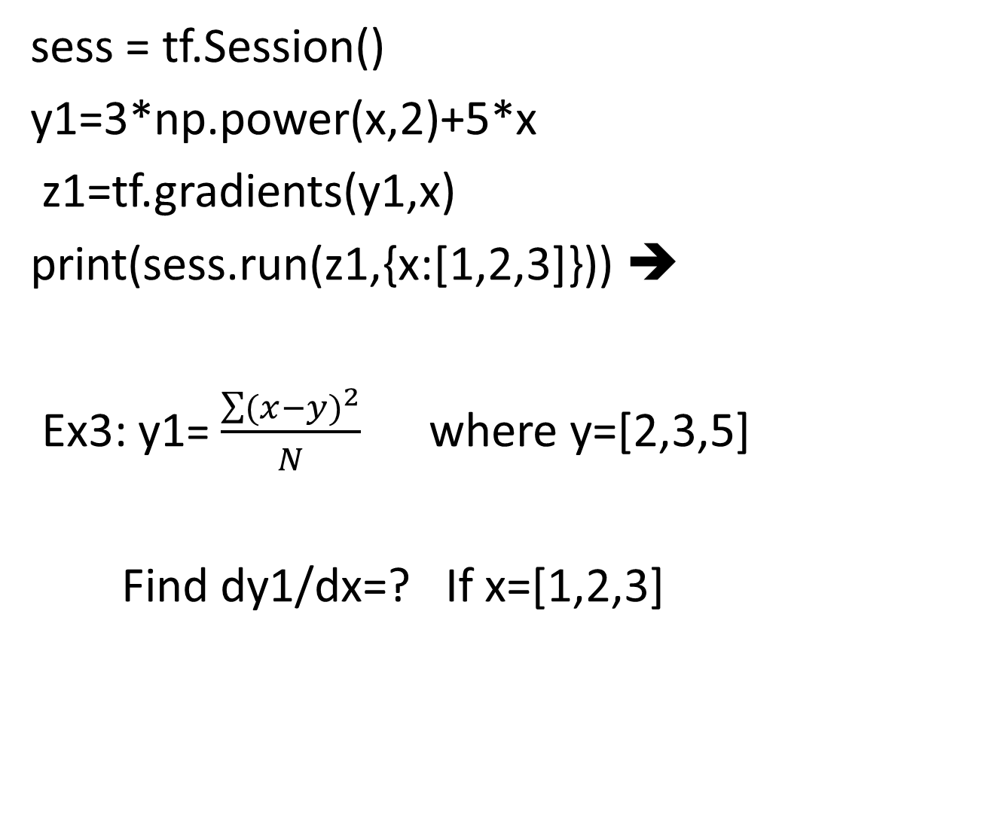
[11., 17., 23.]

Slide 29
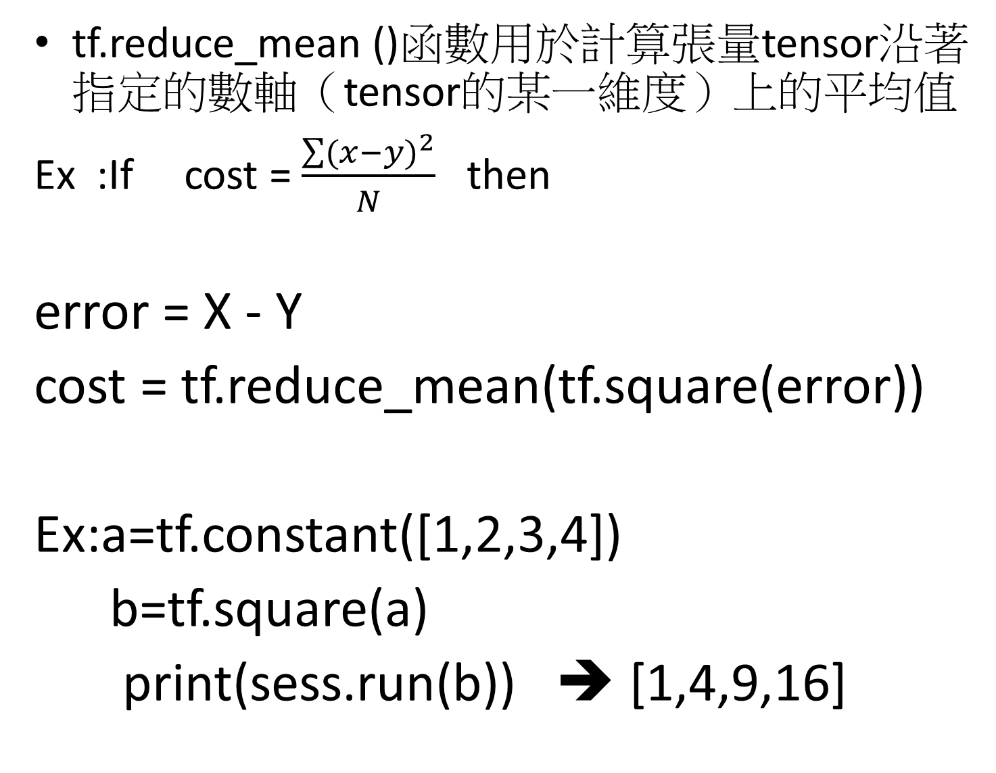

Slide 30
Ex1: Calculate pvalue= c1*a+c2*b
where c1=5.0 and c2=10.0 are constant.
a and b are placeholder
Print( sess.run(pvalue,{a:3,b:4.5}))
Print( sess.run(pvalue,{a:[1,2,3],b:[4,5,6]}))
Ex2 : Using “Tensorflow”
(a) Find tanh([-2,0,1])=?
(b) If f1(x) is sigmoid , find f1([-1,0,2,3])=?
(C) If f2(x) is ReLU, find f2([-5,0,3])=?

Slide 31
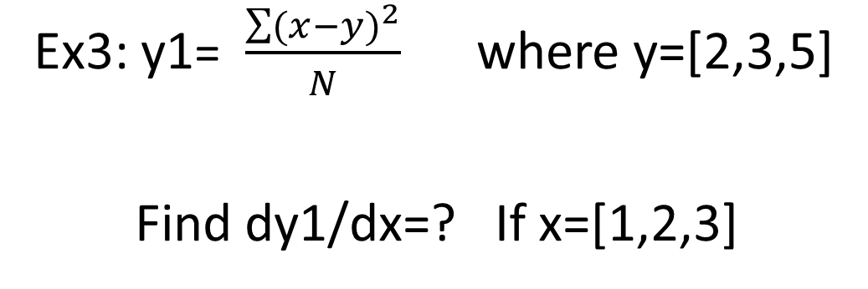
Hint:
error = X - Y
cost = tf.reduce_mean(tf.square(error))

Slide 32
Tensorflow 2.0
TF2.0 : No sessions
a = tf.constant([[10,10],[11.,1.]])
x = tf.constant([[1.,0.],[0.,1.]])
b = tf.Variable(12.)
y = tf.matmul(a, x) + b
print(y)
Tensorflow 2.0中一個主要的改變就是移除tf.Session這一概念．這樣可以説明使用者更好的組織代碼，不用將tf.Session作為一個變數在Python函數中傳來傳去，

Slide 33
Tensorflow 2.0
TF2.0 : No placeholders.
W = tf.Variable(tf.ones(shape=(2,2)), name="W")
b = tf.Variable(tf.zeros(shape=(2)), name="b")
@tf.function
def forward(x):
return W * x + b
out_a = forward([1,0])
print(out_a)
tf.Tensor(
[[1. 0.]
[1. 0.]], shape=(2, 2), dtype=float32)

Slide 34
Hint: error = X - Y
cost = tf.reduce_mean(tf.square(error))
TF1.X
sess = tf.Session()
a = tf.placeholder(tf.float32)
b = tf.constant([2,3,5])
error=a-b
cost= tf.reduce_mean(tf.square(error))
g = tf.gradients(cost,a)
print(sess.run(g,{a:[1,2,3]}))

Slide 35

@tf.function
def dfcost():
b = tf.constant([2,3,5])
error=a-b
cost =tf.reduce_mean(tf.square(error))
return(tf.gradients(cost,a))
a = tf.constant([1,2,3])
print(dfcost())
([-0.6666667, -0.6666667, -1.3333334],

Slide 36
GradientDescentOptimizer
函數training()通過梯度下降法為最小化損失函數增加了相關的優化操作，在訓練過程中，先產生實體一個優化函數，比如 tf.train.GradientDescentOptimizer，並基於一定的學習率進行梯度優化訓練：

Slide 37

GradientDescentOptimizer
GradientDescentOptimizer implements the fundamental full-batch gradient-descent algorithm and takes the learning rate as an input. The gradient-descent algorithm will not loop over the iterations automatically
train_op = tf.train.GradientDescentOptimizer(learning_rate).minimize(cost)
where learning_rate is the constant learning rate and cost is the cost function that needs to be minimized through gradient descent.

Slide 38
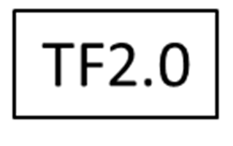
learning_rate=0.01
def prediction(x,weight,bias):
return weight*x+bias
#define cost fucnton
def cost(x,y,weight,bias):
error=prediction(x,weight,bias)-y
squared_error=tf.square(error)
return tf.reduce_mean(squared_error)
#define graduate for eager mode
def grad(x,y,weight,bias):
with tf.GradientTape() as tape:
loss_=loss(x,y,weight,bias)
return tape.gradient(loss_,[weight,bias])
deltaW, deltaB = grad(x, y, W, B) # direction(sign) and value of the gradients of our loss
change_W = deltaW * learning_rate
change_B = deltaB * learning_rate
W.assign_sub(change_W)
B.assign_sub(change_B)

Slide 39
比較一下1.0和2.0 基本原理沒有變。演算法的三個部分，都必須有。
1、定義model
2、定義cost/loss 函數
3、梯度下降優化各個參數。

Slide 40
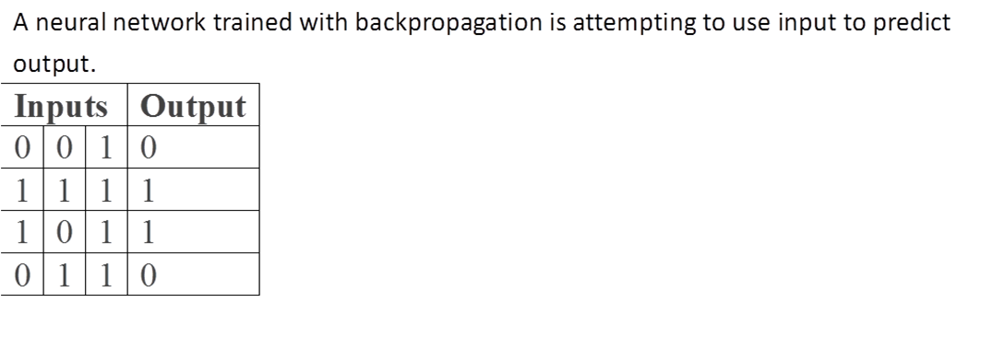
Ex1 :One-Layer Cos Function(I)+ ReLU function
Ex:A Tiny Toy Network
Step 0:(Ex1) input X and Y

Slide 41
Ex1: OneLayer+sigmoid+square(I)
import tensorflow as tf
# 模型參數
W1 = tf.Variable(tf.random_normal([3, 1], stddev=0.03), name='W1')
b1 = tf.Variable(tf.random_normal([1]), name='b1')
# 輸入與輸出的資料
x = tf.placeholder(tf.float32, [4, 3])
y = tf.placeholder(tf.float32)
hidden_out = tf.add(tf.matmul(x, W1), b1)

Slide 42
Ex1: OneLayer+sigmoid+square(II)
# loss function
loss = tf.reduce_mean(tf.square(z1- y))
# sum of the squares
# optimizer
optimizer = tf.train.GradientDescentOptimizer(0.1)
train = optimizer.minimize(loss)

Slide 43
x_train = np.array([ [0,0,1], [0,1,1],[1,0,1],[1,1,1] ])
# output dataset
y_train= np.array([[0,0,1,1]]).T
# 初始化、重設模型參數
init = tf.global_variables_initializer()
sess = tf.Session()
sess.run(init)
sess.run(train, {x:x_train, y:y_train})
curr_W, curr_b, curr_loss = sess.run([W1, b1, loss], {x:x_train, y:y_train})
print(curr_loss)

Slide 44
Epochs=5000
Epochs=5000
# 最佳化迴圈
for i in range(epochs):
sess.run(train, {x:x_train, y:y_train})
curr_W, curr_b, curr_loss = sess.run([W1, b1, loss], {x:x_train, y:y_train})
# 輸出結果
curr_W, curr_b, curr_loss = sess.run([W1, b1, loss], {x:x_train, y:y_train})
print("W: b: loss: ",curr_loss)

Slide 45
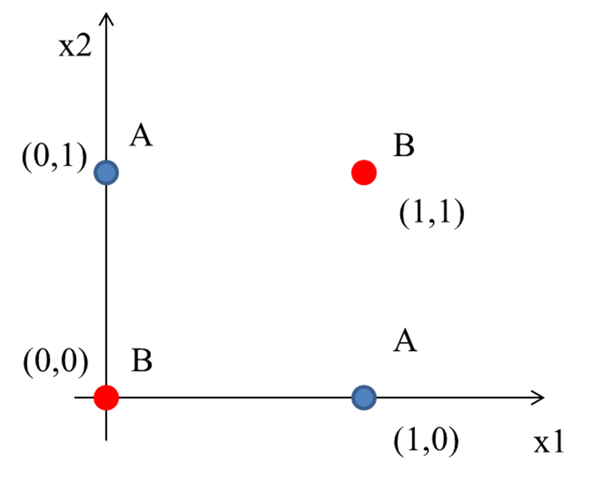
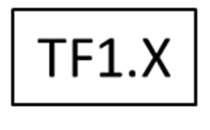
Ex2 :XOR Problem(2Layer)
XOR_X = [[0,0],[0,1],[1,0],[1,1]]
XOR_Y = [[0],[1],[1],[0]]
x = tf.placeholder(tf.float32, shape=[4,2])
y = tf.placeholder(tf.float32, shape=[4,1])
w1 = tf.Variable(tf.random_uniform([2,2], -1, 1))
w2 = tf.Variable(tf.random_uniform([2,1], -1, 1))
b1 = tf.Variable(tf.zeros([2]))
b2 = tf.Variable(tf.zeros([1]))

Slide 46
One Epoch
z1 = tf.sigmoid(tf.matmul(x, w1) + b1)
pred = tf.sigmoid(tf.matmul(z1,w2) + b2)
cost=…
learning_rate = 0.1
Train_op= ….
Print(sess.run(cost,{x:XOR_X,y:XOR_Y}))🡺
0.26321805

Slide 47
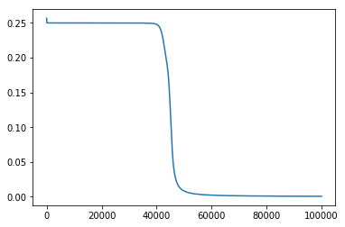
Results
Final Prediction [[0.02478945]
[0.978779 ]
[0.9784483 ]
[0.02222739]]
Cost=0.00050584524
Epochs=100000

